Slide 1
DELE CA2
Reinforcement Learning
SHI TINGXIAO (P2033444)
Tan Yu Hoe (P2026309)

Slide 2
Exploratory Data Analysis

Slide 3
Observation Space
0 | Lander’s X Coordinate
1 | Lander’s Y Coordinate
2 | X Linear Velocity
3 | Y Linear Velocity
4 | Angle
5 | Angular Velocity
6 | Left Leg is touching the ground
7 | Right Leg is touching the ground

Slide 4
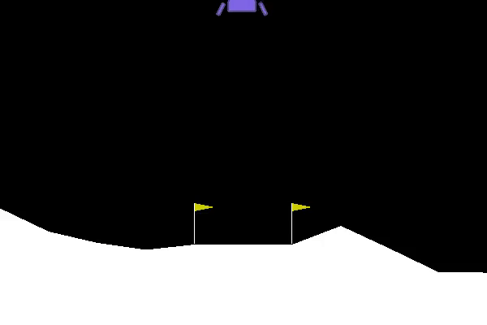
Action 0 Do Nothing

Slide 5
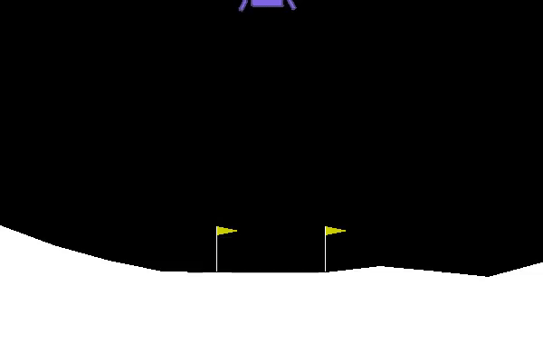
Action 1 Fire Right Engine

Slide 6
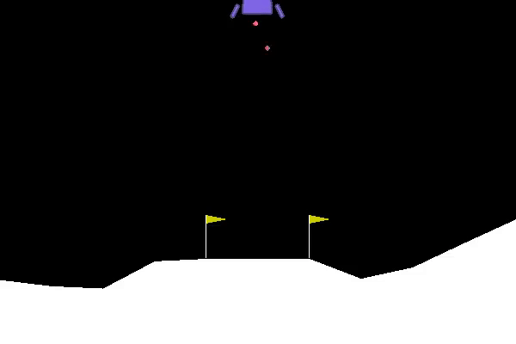
Action 2 Fire Main Engine

Slide 7
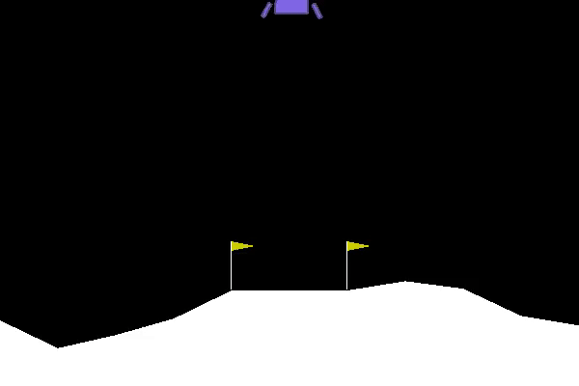
Action 3 Fire Left Engine

Slide 8
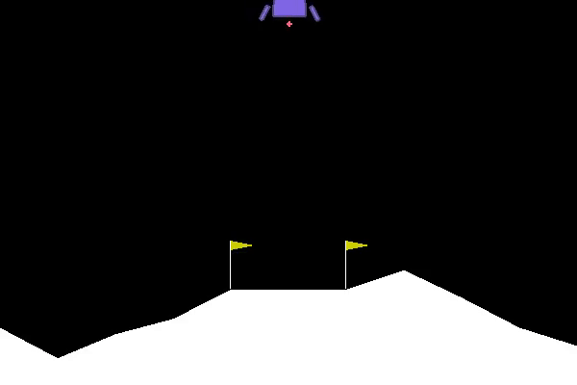
Random Actions

Slide 9
Reward Scenarios
Moving from top of screen to the landing pad and zero speed | +100-140
Moves away from landing pad | Lose Reward
Lander Crashes | -100
Lander comes to rest | +100
Each leg with ground contact | +10
Firing Main Engine | -0.3 per frame
Firing Side Engine | -0.03 per frame
Solving Scenario | ⪭ 200 points

Slide 10
Episode Termination
Lander Crashes
Lander gets outside of the view port
Lander is not awake
In contact with the moon
X coordinate > 1
Body doesn’t move and doesn’t collide with any other body

Slide 11
Models we attempted

Slide 12
Models that we have attempted
Deep Q-Network
Dueling Deep Q-Network
Double Dueling Deep Q-Network
Actor
To
Critic

Slide 13
Deep Q Learning
01
Value Based Model

Slide 14
What is Deep Q Learning
Deep Q Learning is an extended version of Q Learning
Instead of approximating Q value using a function
Deep Q Learning uses a neural network to approximate Q
Notes:
Deep Q learning is can be thought of an extension to q learning. Instead of approximating Q value using a function, a neural network and a policy is used to approximate Q instead.

Slide 15
Experience Replay and Replay Buffer
Store past experiences
Uses a random subset of these experiences to update the Deep Q-Network
Contains a collection of experience as a Tuple
(State, Action, Reward, New State)
A buffer is added to the end so that it pushes the oldest experience out
Notes:
The Deep Q network uses a collection class called “replay buffer” to perform this technique called “experience replay”. The intuition is to store past experiences, then use a random batch of experience to update the q network. There is also a concept of buffer size, where if there replay buffer reaches it max limit, it will add experience at the end and remove the oldest experience out.

Slide 16
Target Network
When neural networks parameters are updated to Q(s, a)
Q(s’, a’) and other nearby states are also affected.
Makes training unstable
Target Network makes a copy of the Deep Q-Net to serve as stable target every N number of steps.
The Target Network is used to create Q(s’, a’)
Notes:
Most of the Deep Q Networks also include something called a target network. Let’s say we have this problem, the neural network is updated and adjusted to one specific state. However, this is a problem as the updated neural network as it might affect the next state and other nearby state, since we do not know that the next state will do better or worse. This implementation was found to make training unstable. Target Network mitigates this problem by making a copy of the Deep Q -Net at the start of every N number of steps. For most of our implementation, we use 120 steps as N. Then this target network is used to create the next state and the following state.

Slide 17
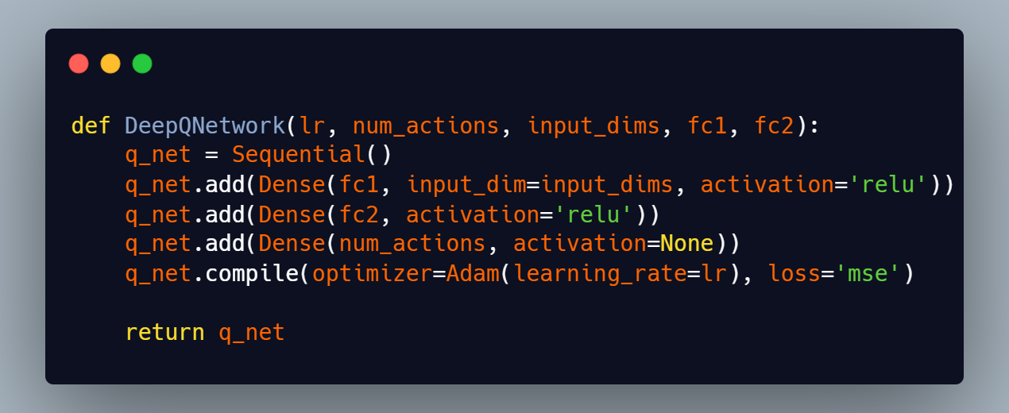
Deep Q Network Architecture
Input layer taking in 8 states
Two FC Hidden Layers with 256 nodes with ReLU Activation
FC Output Layer with 4 nodes
Compiled with Adam Optimizer and MSE Loss

Slide 18
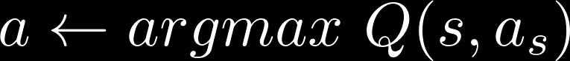
DQN Policy
Takes the highest Q-value of the current state and chooses the action with the high Q-value. (using `.argmax()` operation)
Explores the environment by randomly choosing actions for the first few episodes.

Slide 19
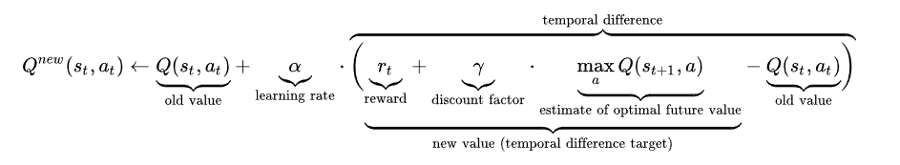
Training Function
For every State
Copy QNet over to Target QNet (Every 120 steps)
Sample a batch of experience
Get Q value for the current state
Calculate Target Q Value using reward, discount factor, and the max Q value
Network performs backpropagation using state and target Q value.
Notes:
The training function for Deep Q net are as follow, the current Q Net is copied over to the target Q Net.
The agent sample a batch of experience from the replay buffer
The Q value is retrieved from the current state
We then calculate the target q value using reward, discount factor, and the max q value
Finally, the network performs backpropagation using state and target Q value.

Slide 20
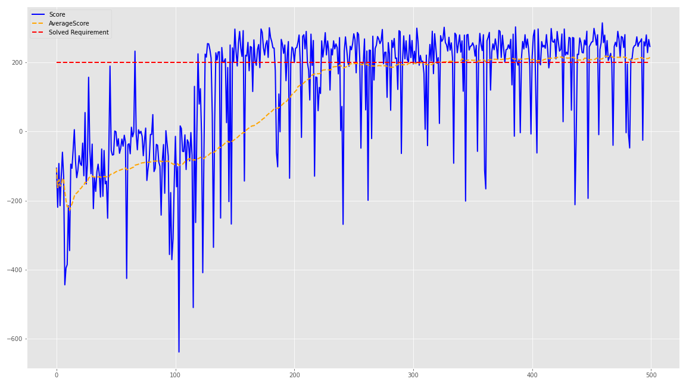
DQN Train 500 Episodes
Notes:
I trained the agent for a 500 episodes. Generally, the agent is able to train steadily up until episode 300, where the average reward passed 200, where it is considered to be solved. The average reward peaked at 210 before it diminished. As for testing, I will load the agent saved at episode 499.

Slide 21
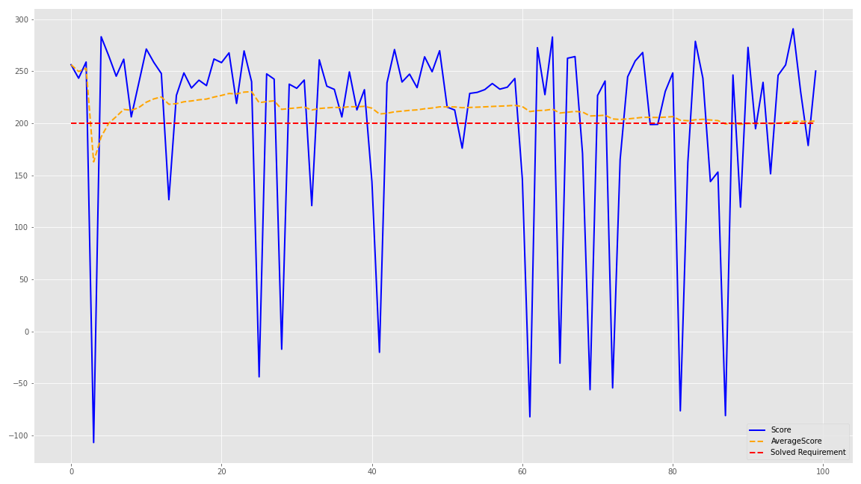
DQN Test 100 episodes
Notes:
As for testing, we can see that the trained DQN is maintaining an average reward slightly above 200. We can also see that for 17 episodes, the score dropped below the 200 score benchmark. This is could be assume that the network has 17 out of 100 chance to fail in the lunar lander environment.

Slide 22
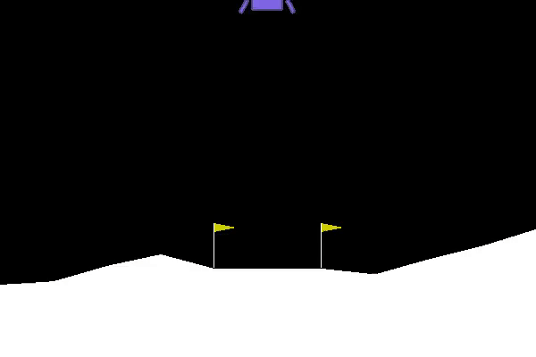
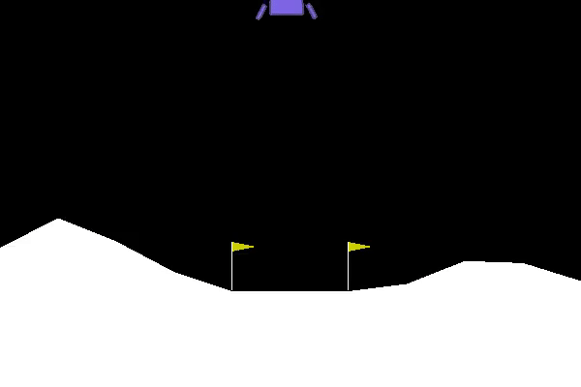
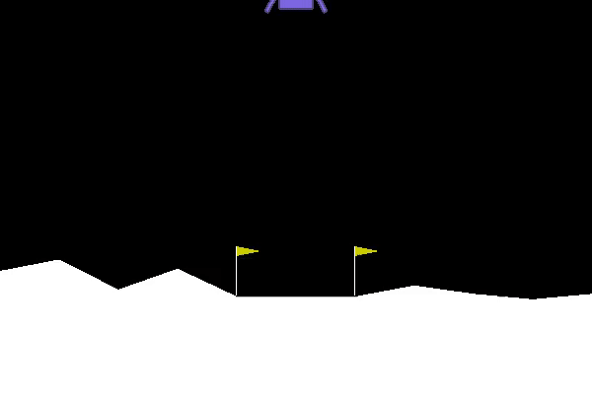
DQN Video Showcase
Notes:
Generally, we can see that the spacecraft is able to land successfully on the landing pad, some with a leg sticking out of the landing pad.

Slide 23
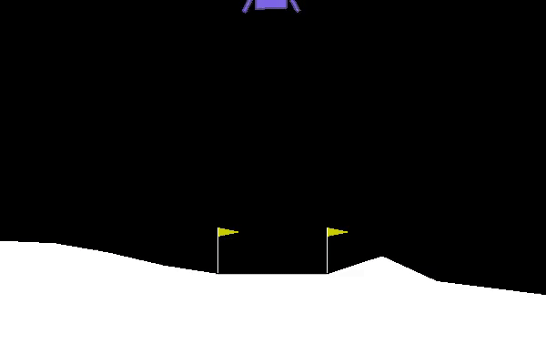
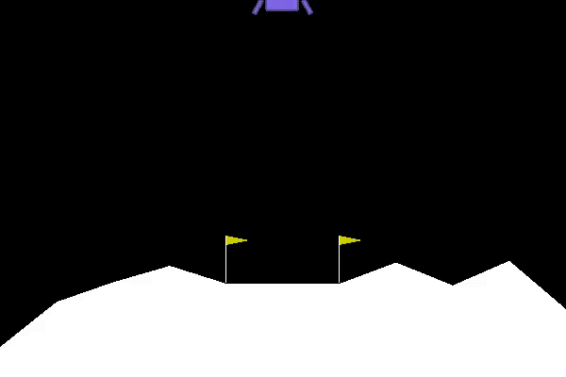
DQN Video Showcase
Notes:
The same follows for this example.

Slide 24
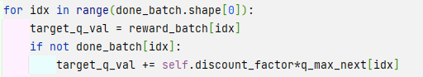
The problem of Single DQN
Temporal Difference learning makes DQN overestimate action-values.
TD target utilised maximization, TD target is bigger than the real action-value
Since TD target is overestimated, bootstrapping propagates the overestimation
Since each overestimation is bootstrapped, once DQN overestimates, it will be a vicious circle of overestimation.
Notes:
However, since DQN takes the highest Q-value of the current state and chooses the action with the high Q-value, the temporal difference makes DQN overestimate the action value, since every TD target is overestimated, the overall propagation is bootstrapped and even more overestimated

Slide 25
Dueling Deep Q-Network
02
Value Based Model

Slide 26
What is Dueling Deep Q-Network
The model is represented by the equation below,
Q = V + A - mean of all A
The model consists of two estimators
State value function V
State dependent action advantage function A
These two estimators are combined to generate the action-value function
The benefit is that the state-value function is quicker and easier to learn → Faster Convergence
Notes:
Next part we implemented Dueling Deep Q Learning. The basic intuition is that the network has two heads, state value function V and action advantage function A. These two functions are then combined to produce the Q value.

Slide 27
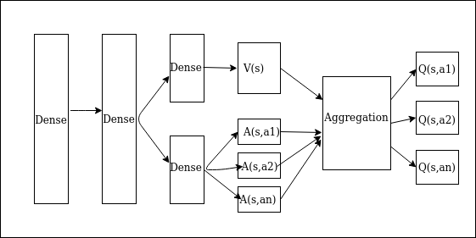
What is Dueling Deep Q-Network
Notes:
This is a diagram above shows a visual representation of a Dueling Deep Q Network. The network is split into two heads, a value function and an Advantage function. These two functions are then aggregated into Q value.

Slide 28
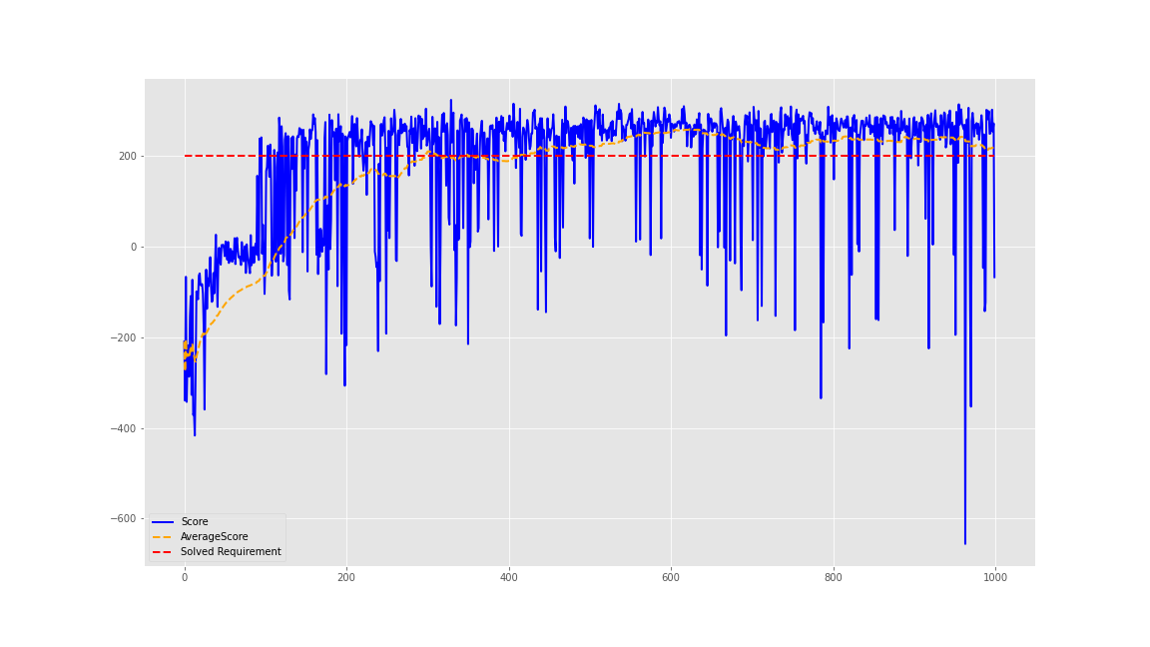
DDQN Train 1000 Episodes
Notes:
I trained the agent for a 1000 episodes. Generally, the agent is able to train steadily up until episode 300, where the average reward passed 200, where it is considered to be solved. The training continues until it peaked at episode 616, where the average reward surpassed 257. As for testing, I will load the agent saved at episode 616.

Slide 29
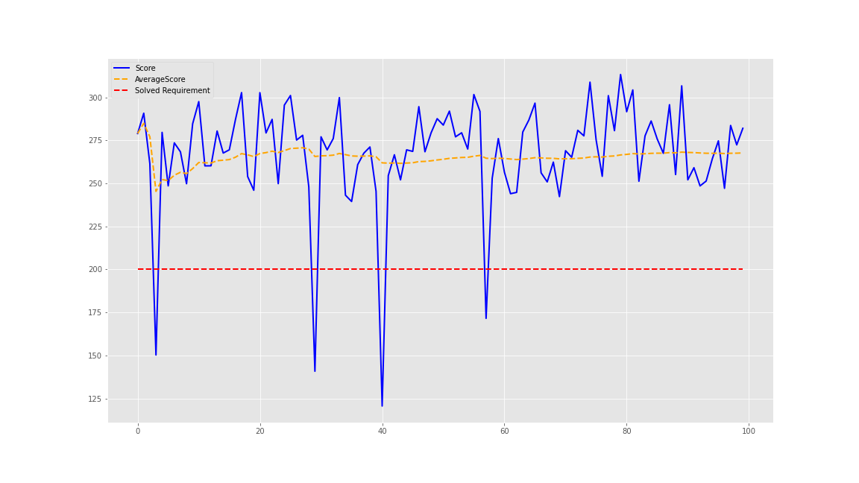
DDQN Test 100 episodes
Notes:
We tested the agent for a 100 episodes. The agent steadily maintained an average reward around 250, with only 4 episodes encountering a dip. Thus, we can assume that the agent as a 1 in 25 chance to fail the Lunar Lander environment.

Slide 30
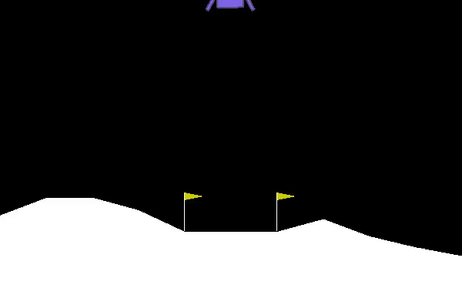
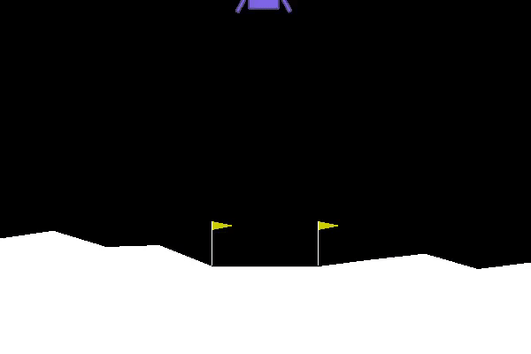
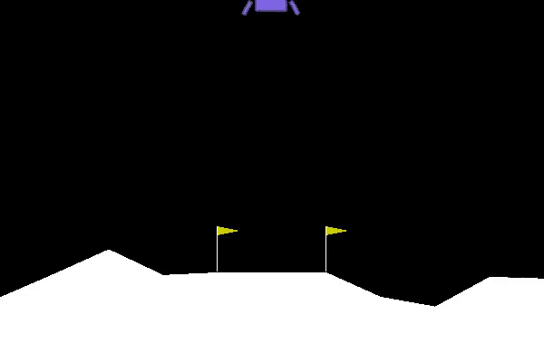
DDQN Video Showcase
Notes:
Across all of the showcase shown here, we can see that the agent has the same strategy of descending faster at the start. Then decelerating when it approaches the landing pad.

Slide 31
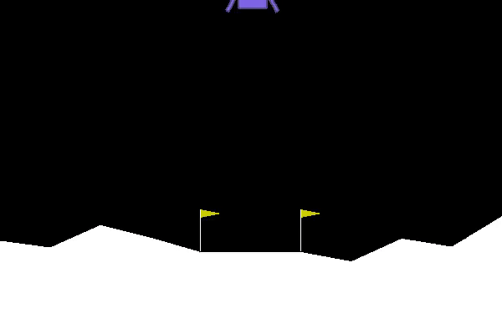
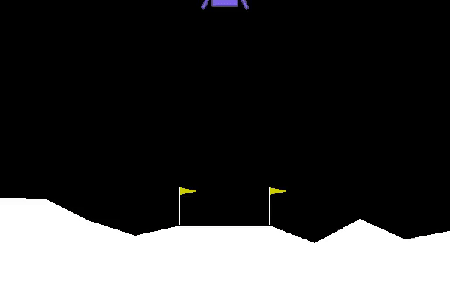
DDQN Video Showcase
Notes:
Furthermore, it seems to be more accurate it terms of aligning itself to the center of the landing pad.

Slide 32
Cross Comparison DQN vs DDQN
Deep Q-Network
Dueling Deep Q-Network
Notes:
A cross comparison between the DQN and DDQN I have trained so far. It seems that the DDQN has a faster strategy to approach the landing pad and more accurate in terms of pinpointing the center of the landing pad.

Slide 33
Double Dueling Q-Network
03
Value Based model

Slide 34
What is Double Dueling Deep Q Learning
The double dueling DQN is pretty similar to the Dueling DQN, there are two consisting estimator - the state value function, and the state dependent action advantage function.
However there is an issue with single DQNs. The first time an agent receives a positive reward, it might continue making the same set action. A solution to solve this problem is to use two action value functions, in other words, two lookup tables. The agent uses one to update the other Q-value, providing an unbiased estimate of Q(s, a).
Notes:
Single DQN is prone to overestimation, its action-value will

Slide 35
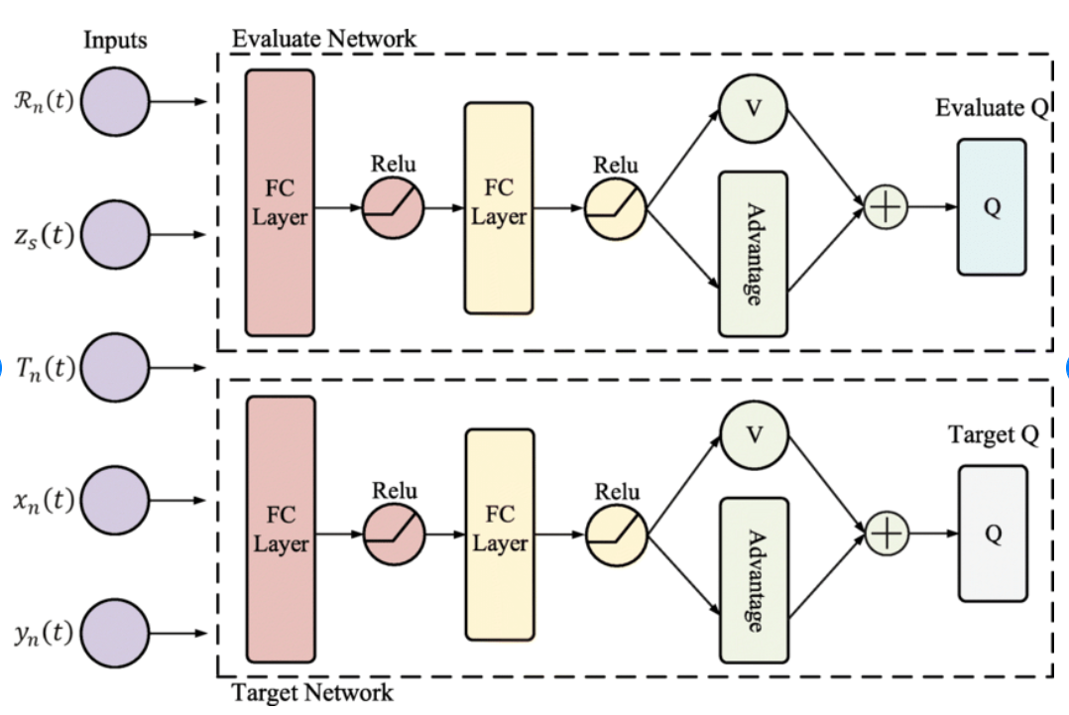
What is Double Dueling Deep Q Learning
Notes:
So here is the visualization to the model, there are 2 action value functions.

Slide 36
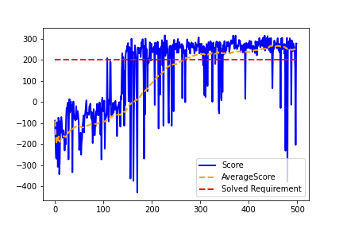
D3QN Train 500 episodes
Notes:
After 500 episodes, the average score reward of the model is able to stay consistent above 200.
It kept improving from the first episode until around 300. Compare to the Dueling DQN, the model reached

Slide 37
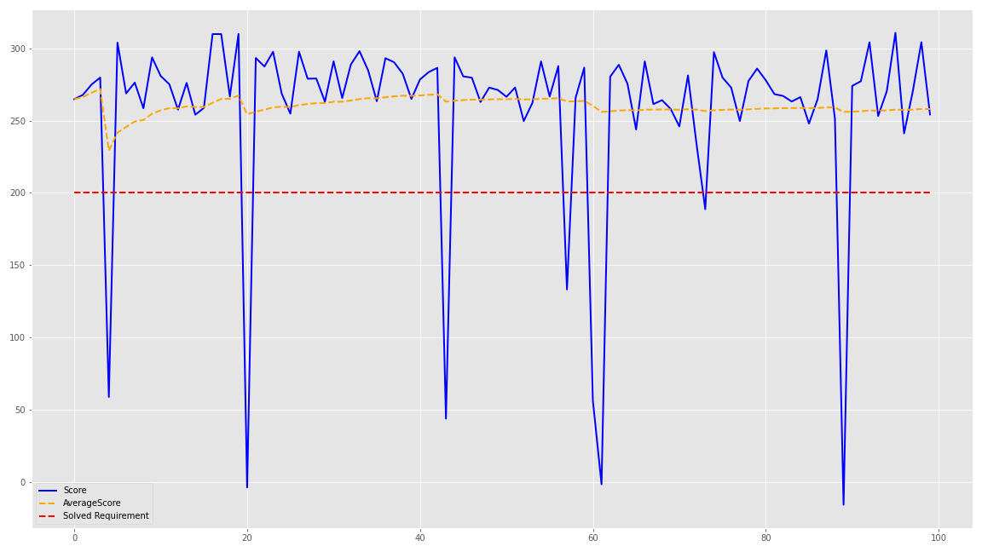
D3QN Test 100 episodes

Slide 38
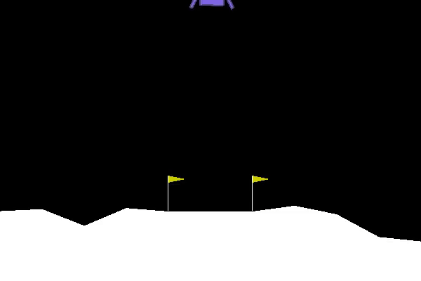
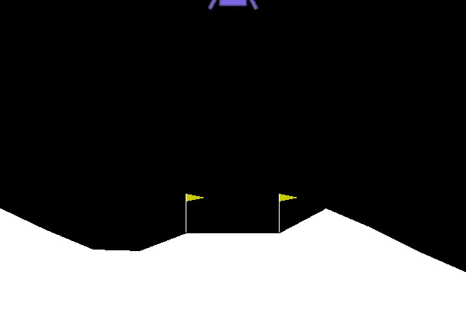
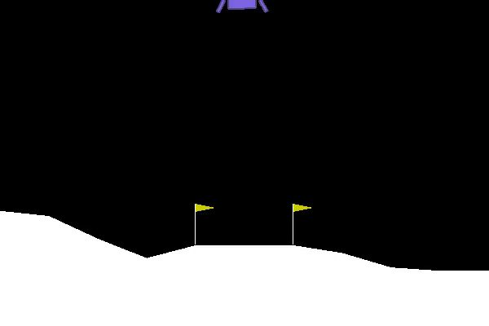
D3QN Video Showcase
Notes:
The lander is able to perform a soft landing and go straight towards the center of the landing pad

Slide 39
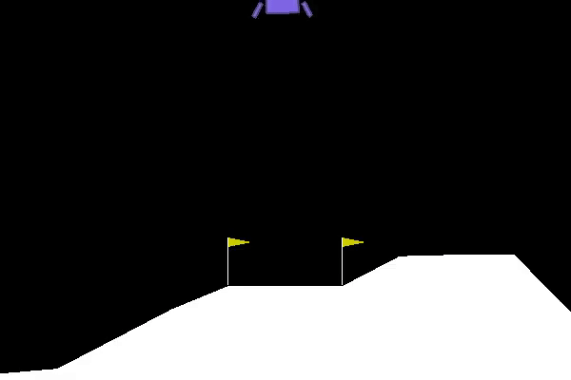
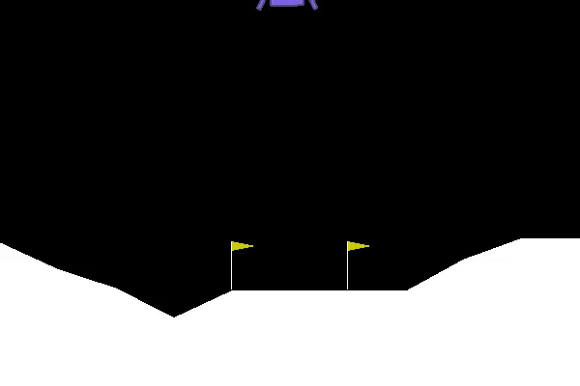
D3QN Video Showcase

Slide 40
Cross Comparison
D3QN
DDQN
Notes:
Now here is a comparison between the dueling and double dueling, as said before single DGN is prone to overestimate their action values. As a result on the screen, you can clearly see that Dueling DQN is a bit more rocky in its landing, while D3QN is much more smooth

Slide 41
Actor to Critic
04
Value and Policy based model
Notes:
So the previous model are all value based modes

Slide 42
What is Actor to Critic
Actor critic network is a combination of policy-based method and value based method
Actor is a policy network, it actively trying to
Search for the best policy in the action table given state s
Policy(s) = argmax а (Q[s,a])
Critic is a value network, it rates the action, and help actor learn

Slide 43
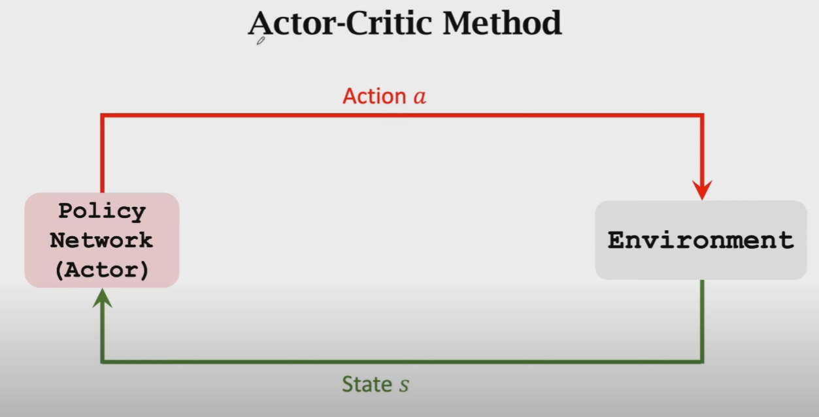
Actor’s Role
Notes:
The actor see the current state and react by committing action A, the goal of the actor is to make sure that itself is improving.

Slide 44
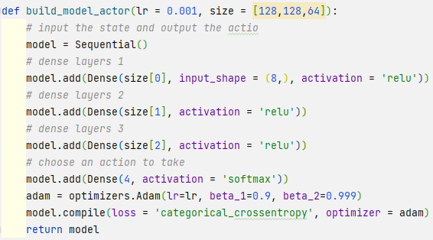
Actor network
With the input of 8 states, the actor network would choose which action to take, the dense layers using relu activation while the last dense uses softmax.
Notes:
this is the actor network model

Slide 45
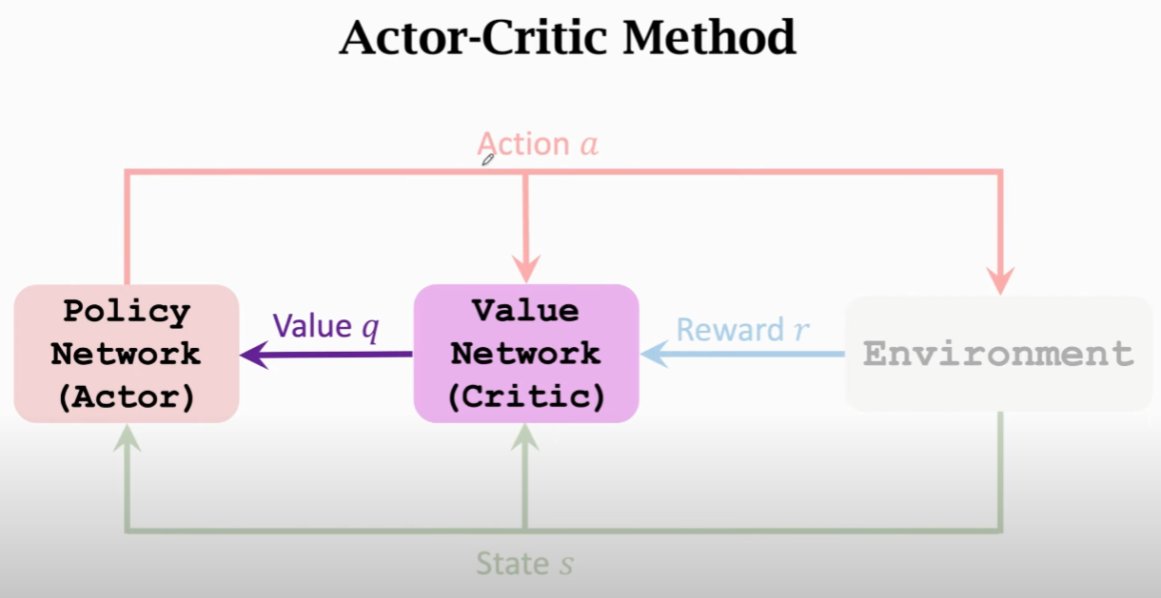
Critic’s Role
Notes:
To better help the actor to gauge its performance, we introduce the critic network, the critic will provide a score, based on the state s and action a. The critic’s score will be used to update the actor’s weight by the method of temporal difference

Slide 46
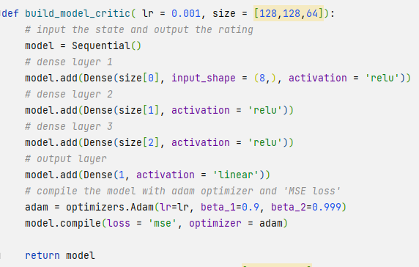
Critic Network
With the input of 8 states, the critic network will produce a score.

Slide 47
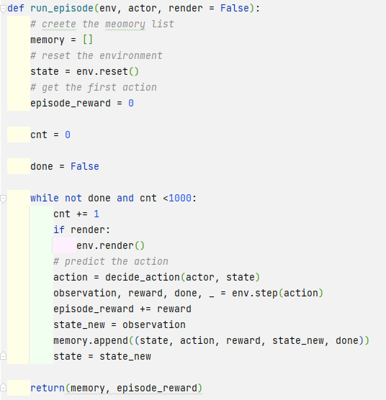
Run Episodes
When the state is not done(either success or crash) or action is less than 1000 (to give model time to react to the env) the episode will still be running.
The memory stores the continuous state, reward and action.

Slide 48
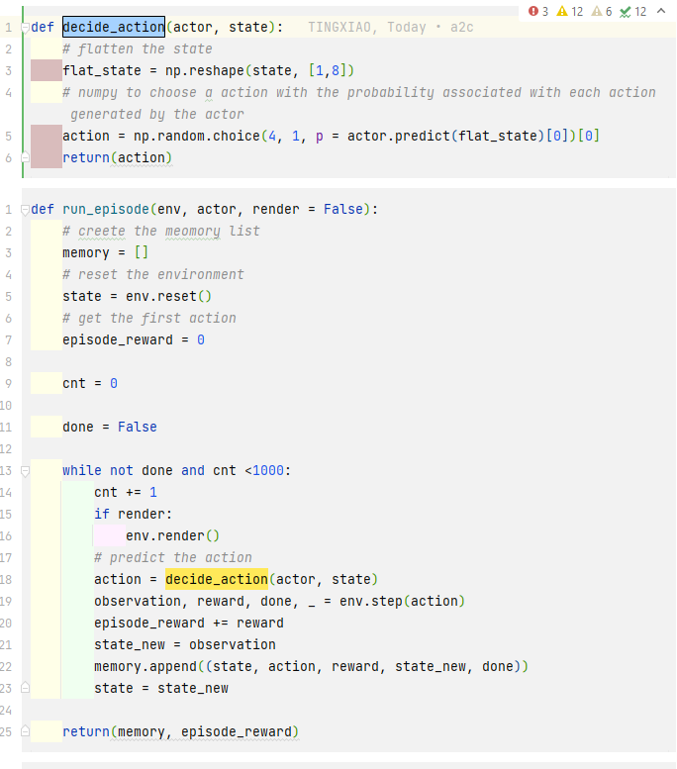
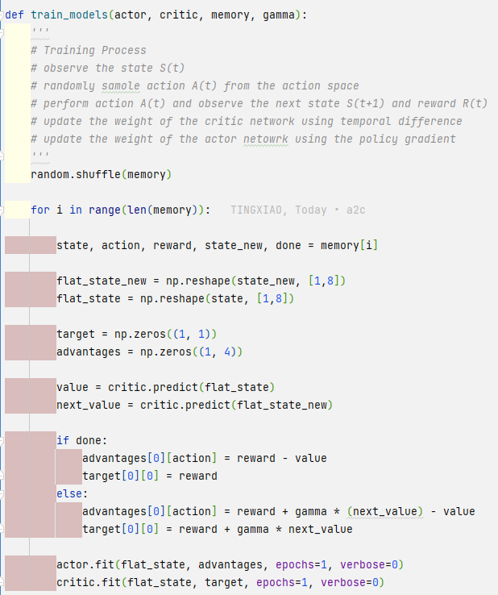
Training Process
Actor observe the state S(t)
Actor randomly sample action A(t) from the action space
Actor perform action A(t) and observe the next state S(t+1) and reward R(t)
update the weight of the critic network using temporal difference
update the weight of the actor network using the policy gradient
Notes:
Actor observe the state S(t)
Actor randomly sample action A(t) with the probability associated with each action generated by the actor
Actor perform action A(t) and observe the next state S(t+1) and reward R(t)
the weight of the critic network will be updated using temporal difference
the critic will observe both current state and next state, generate its score
update the weight of the actor network using the policy gradient

Slide 49
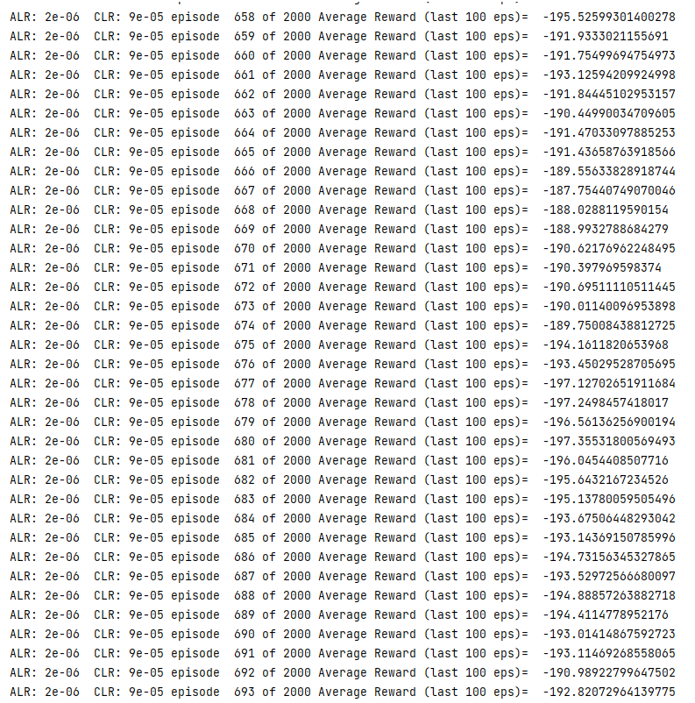
Performance
The performance was far from ideal, after 700 episode, the model was not improving. As all RL models, uncertainty is prevalent. Especially in this case, we need to find the perfect balance between two models in order to make it perform. And we simply ran out of time and computing power.

Slide 50
Conclusion
Relatively, we can see that the different Q-Networks are more consistent in meeting the solved requirements.
DQN was also found to be overestimating over a single state, hence our decision to improve to DDQN and D3QN

Slide 51
Further Improvement
Due to time constraint, we could not fully implement the A2C network.
We could try to implement more RL algorithm such as Proximal Policy Optimization (PPO), Variational DQN, or even Google’s Evolving Reinforcement Learning Algorithm
We could also try different hyperparameters such as Learning Rate, 𝛄 Discount Factor, Batch Size
We could also try to change the Loss Function to Huber Loss to minimise the effect of outliers.

Slide 52
Thanks!

